Slide 1
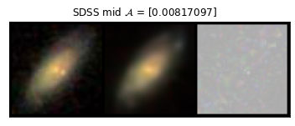
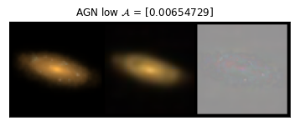
Quantitatively rate galaxy simulations against real observations with anomaly detection
Zehao Jin
2023/03/22
PhD student, New York University Abu Dhabi

Slide 2
Rate galaxy simulations with scaling relations
A metric to rate simulations against observations is crucial to test the physics implemented in simulations.
The agreement with galaxy scaling relations is the main metric
Tully - Fisher
stellar mass – halo mass
size – mass
mass – metallicity
Notes:
Why need to rate?
Usual way to rate: scaling relations
What is scaling relations

Slide 3
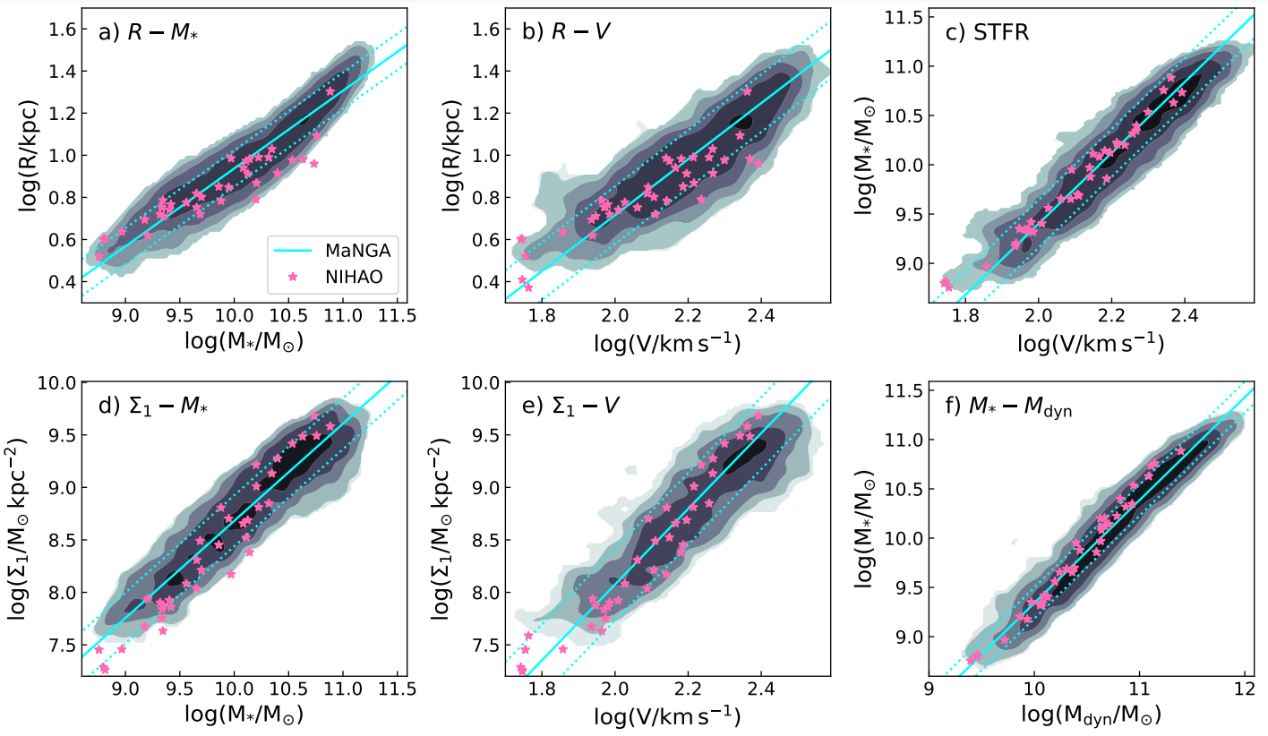
Arora et al. (in prep)

Slide 4
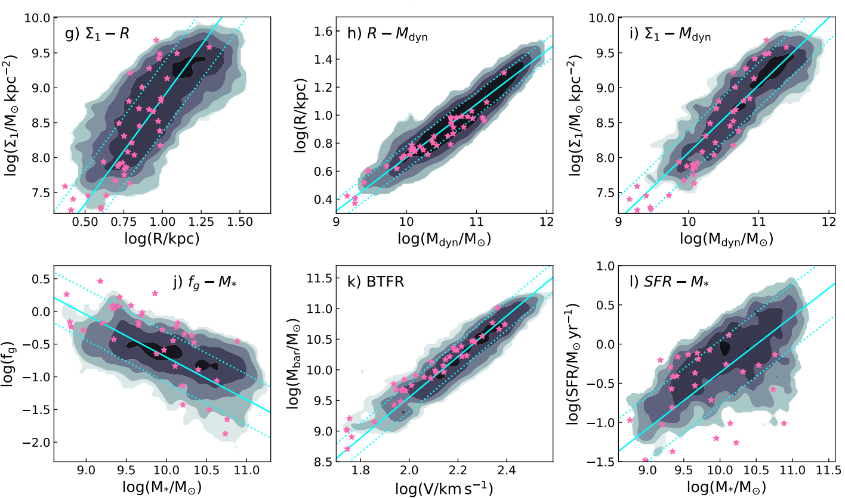
Arora et al. (in prep)

Slide 5
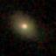
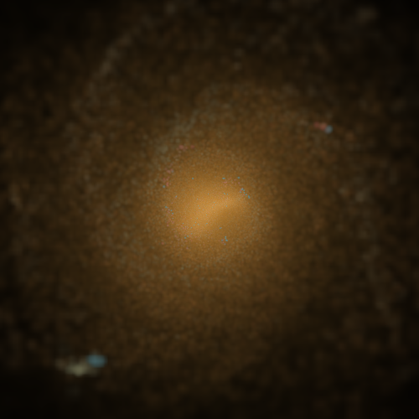
Why compare two numbers only?
SDSS galaxy
i-r-g band RGB image
NIHAO simulated galaxy
Mock observed in i-r-g band

Slide 6
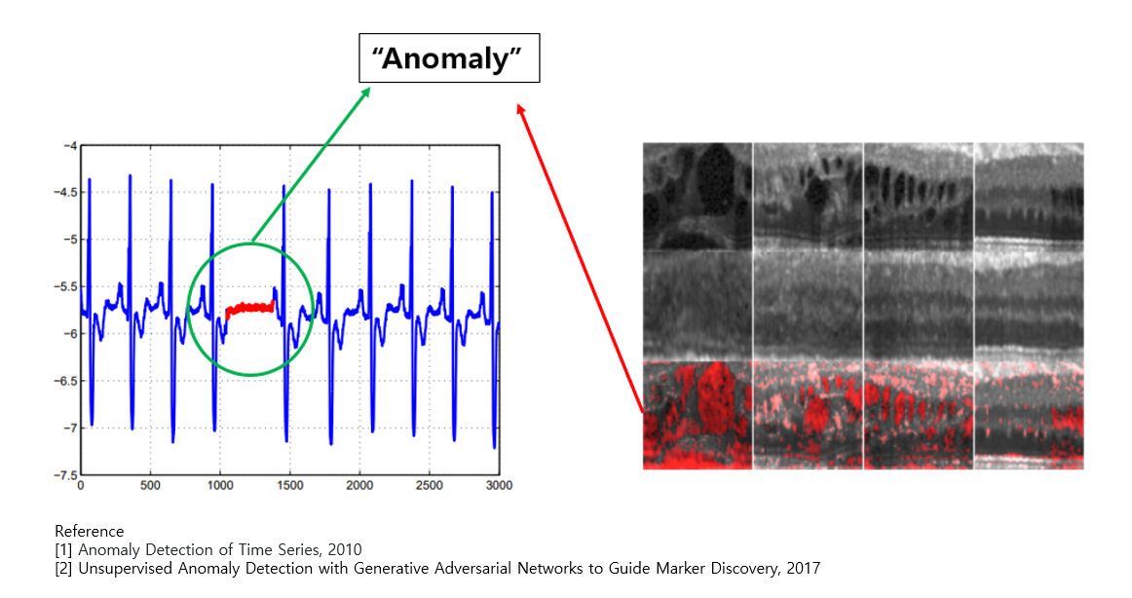
SDSS vs. NIHAO with images
Anomaly detection

Slide 7
Anomaly detection
Treat SDSS images as “normal” set
“Look for” anomaly in NIHAO images
Should returns a “score” that quantifies how normal or abnormal NIHAO images are
Should tell us where the anomaly is located
Deep learning anomaly detection to help

Slide 8
GANomaly
Deep learning anomaly detection algorithm developed by Samet Akcay et al.
GANomaly: Semi-Supervised Anomaly Detection via Adversarial Training (https://arxiv.org/abs/1805.06725)
Anomaly detection by reconstruction
Train a neural network to reconstruct normal data
The trained network should not be able to reconstruct data with anomaly

Slide 9
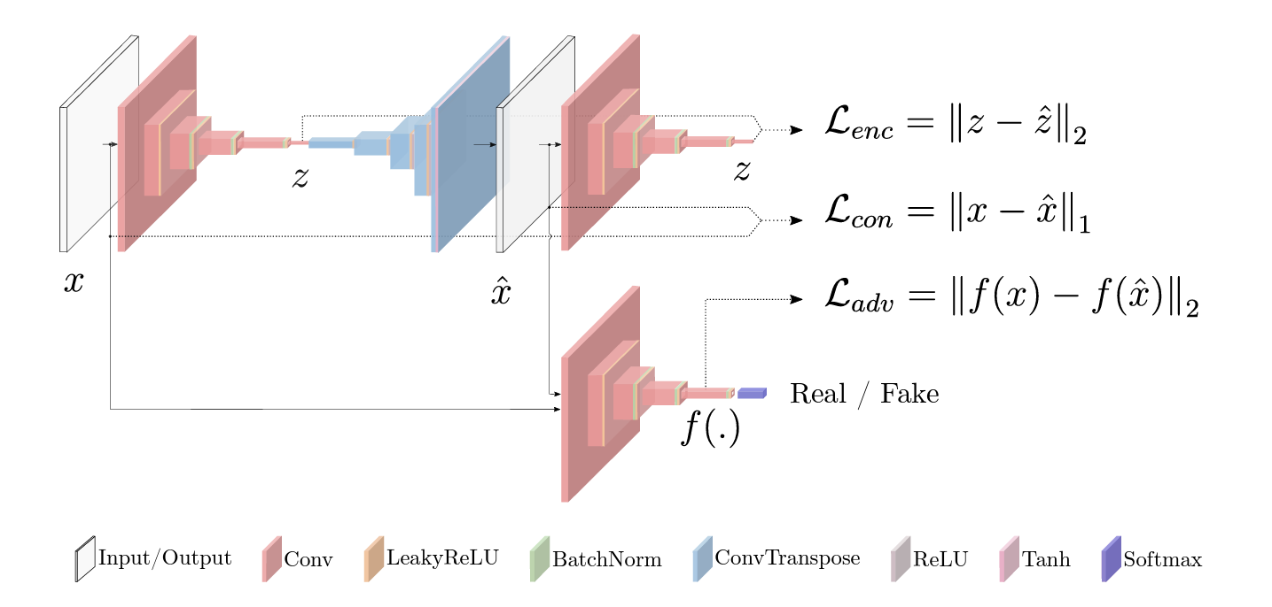
GANomaly
Encoder1
Decoder
Encoder2
Discriminator
$x$ – input/original image [64*64*3] , $\hat{x}$ – reconstructed image [64*64*3]
$z$ – “feature”/latent space of $x$ [128*1*1] , $\hat{z}$ – “feature”/latent space of$\hat{x}$[128*1*1]

Slide 10
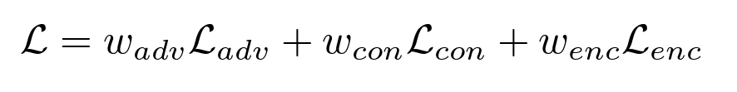
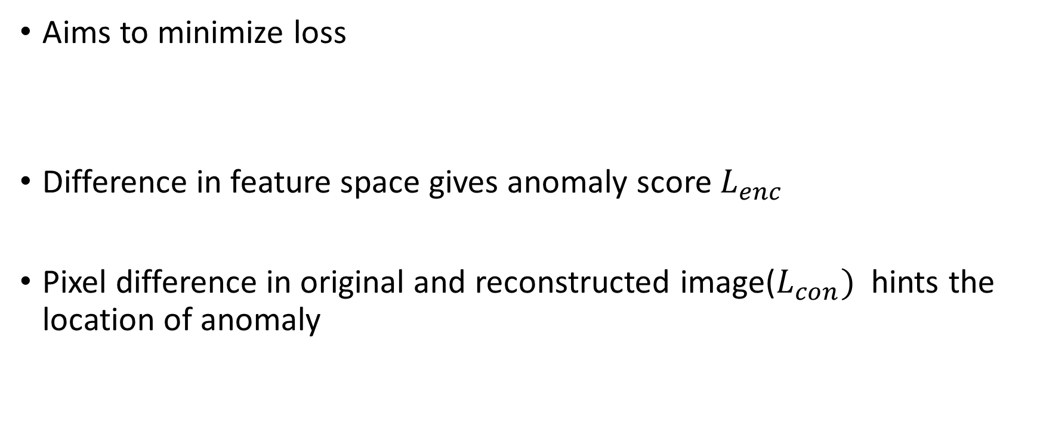
GANomaly
Aims to minimize loss
Difference in feature space gives anomaly score $L_{enc}$
Pixel difference in original and reconstructed image($L_{con})$ hints the location of anomaly

Slide 11
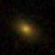
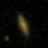
SDSS galaxy images
i-r-g band to RGB images
SDSS Galaxy catalog from Meert et al.(2015)
64*64 pixel cutouts, with 0.396’’/pix
579197 (90%) as training set, 64356 (10%) as testing set
The training is fully done on SDSS images
Hundreds thousands of SDSS images vs. a few hundreds of NIHAO galaxies

Slide 12
NIHAO galaxy images
NIHAO (Numerical Investigation of Hundred Astrophysical Objects)
Hydrodynamical, zoom-in, powered by the GASOLINE2
flat ΛCDM cosmology, with Planck satellite parameters
Compton cooling
photoionization
star formation and feedback(supernovae &massive stars)
metal cooling
chemical enrichment

Slide 13
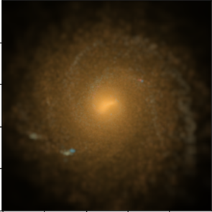
NIHAO galaxy images
SDSS-style mock observation
Age + metallicity + color-magnitude diagram --> light in SDSS i-r-g band
A simple dust screening is applied, but no serious radiative transfer.
arcsinh stretch as done by SDSS (Lupton et al. 2004)
3D simulation to 2D images
Each galaxy is projected in 20 random orientations
~100 NIHAO galaxies in total
81 NIHAO NoAGN
81 NIHAO AGN
12 NIHAO n80
6 NIHAO UHD

Slide 14
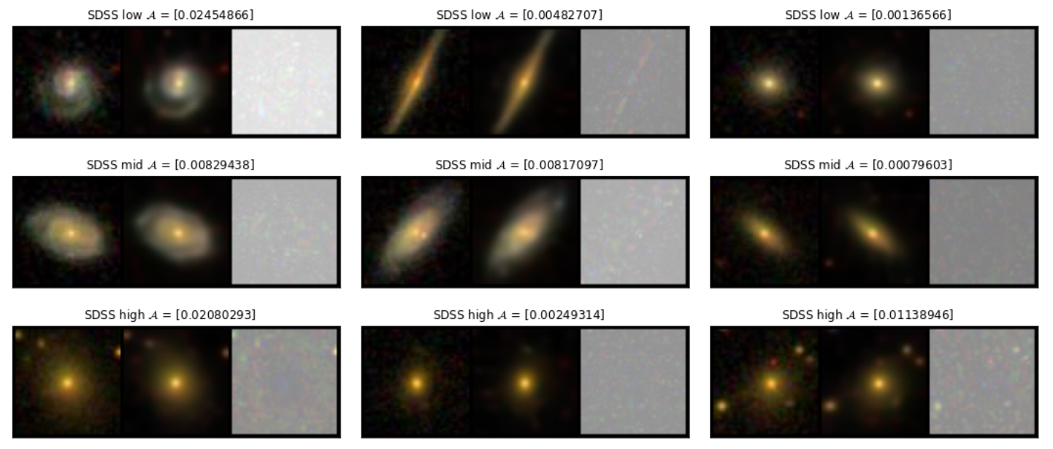
Gallery - SDSS
Original | reconstructed | residual

Slide 15
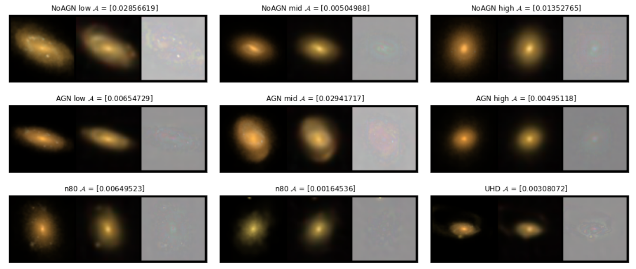
Gallery - NIHAO
Original | reconstructed | residual

Slide 16
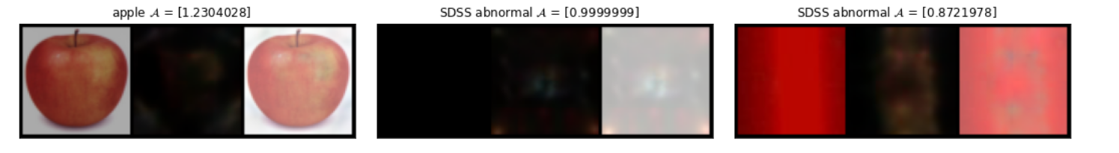
Gallery - Sanity check
Original | reconstructed | residual

Slide 17
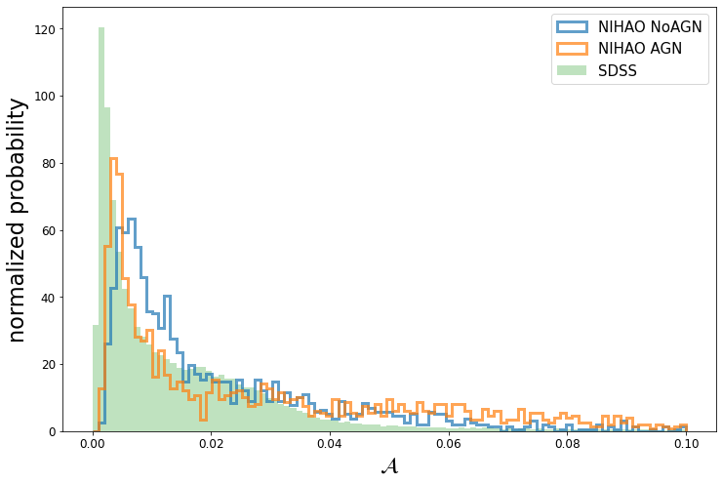
Anomaly score overview

Slide 18
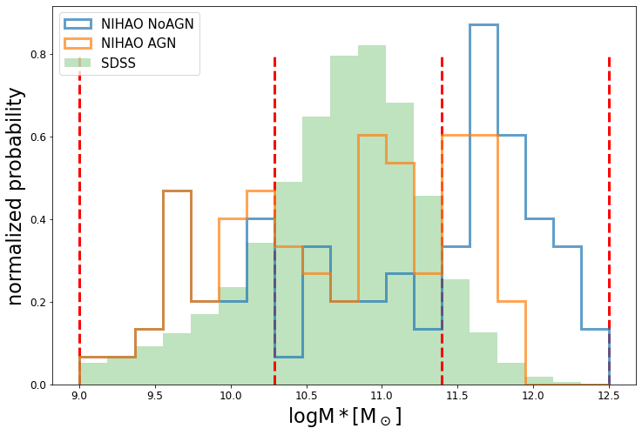
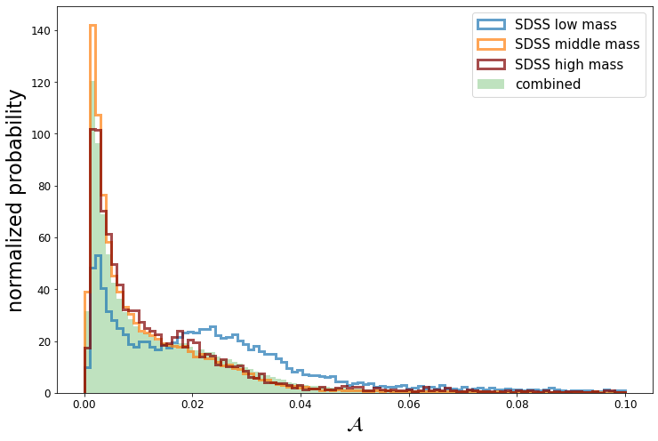
Stellar mass distribution -- compare apples with apples

Slide 19
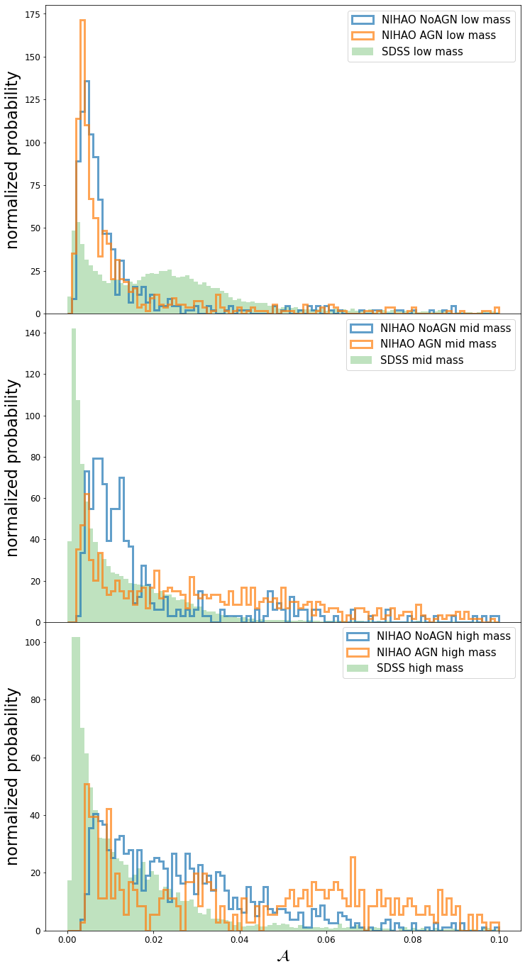
AGN vs. NoAGN
AGN feedback is essential in quenching of massive galaxies
Low mass bin
nearly the same as expected
Mid & high mass bins
Slightly different distribution
But scores seems to be equally bad

Slide 20
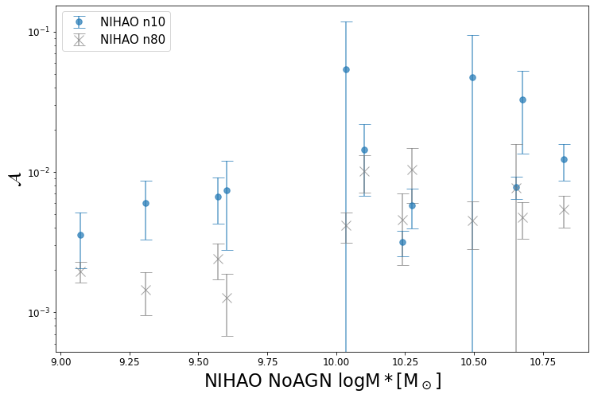
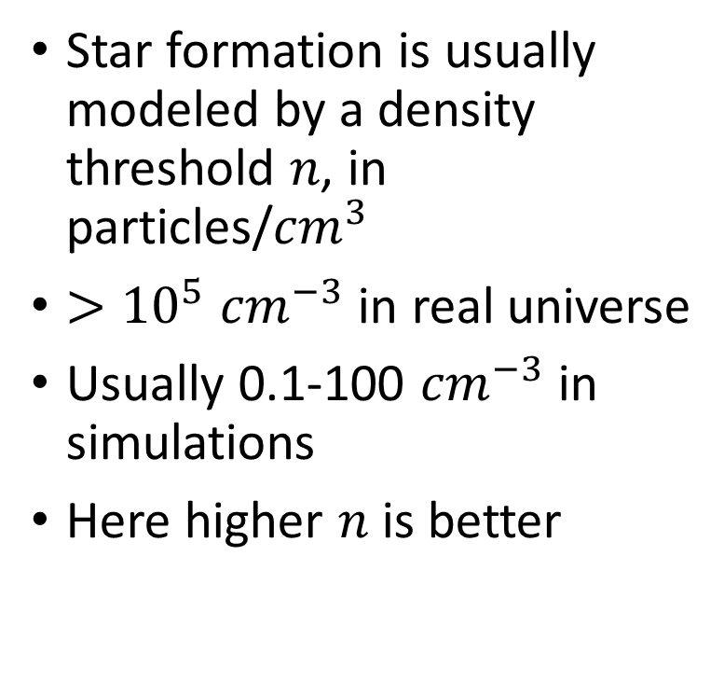
Different star formation density threshold
Star formation is usually modeled by a density threshold 𝑛, in particles/${cm}^{3}$
$>{10}^{5}$ ${cm}^{−3}$in real universe
Usually 0.1-100 ${cm}^{−3}$ in simulations
Here higher 𝑛 is better

Slide 21
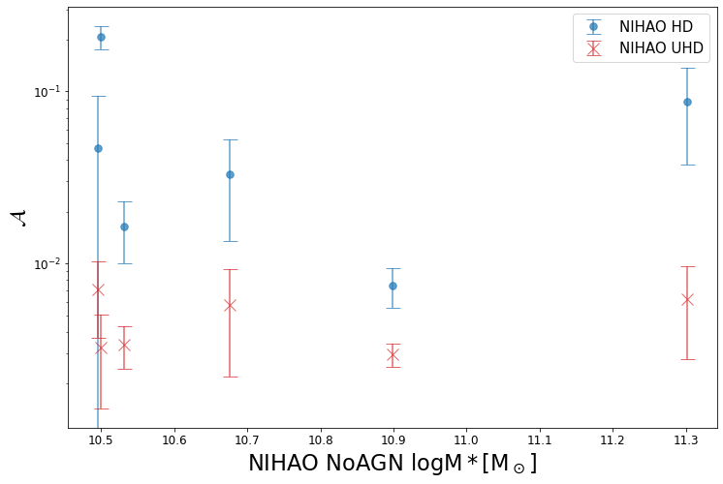
Different resolutions
HD (high definition)
UHD (Ultra high definition)
Higher resolution helps!

Slide 22
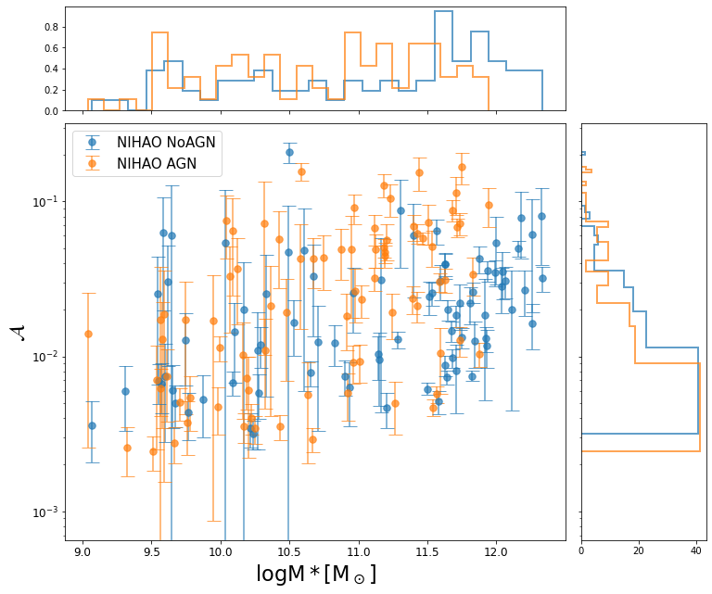
𝒜 vs. Scaling relation quantities
𝒜 increases as stellar mass increases in NIHAO
For SDSS, in contrary, low mass ones has higher 𝒜
More simulation efforts is needed to improve the modeling of high mass galaxies

Slide 23
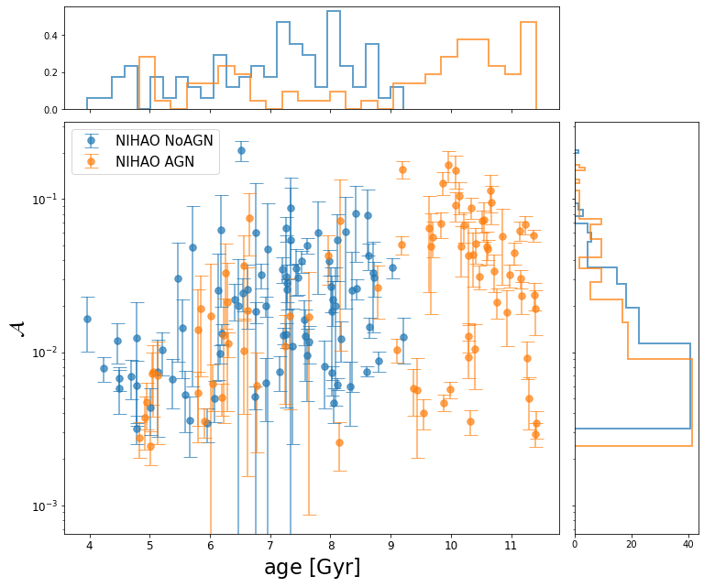
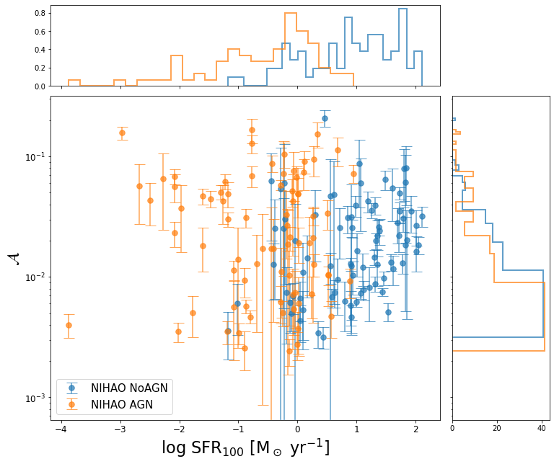
𝒜 vs. Scaling relation quantities

Slide 24
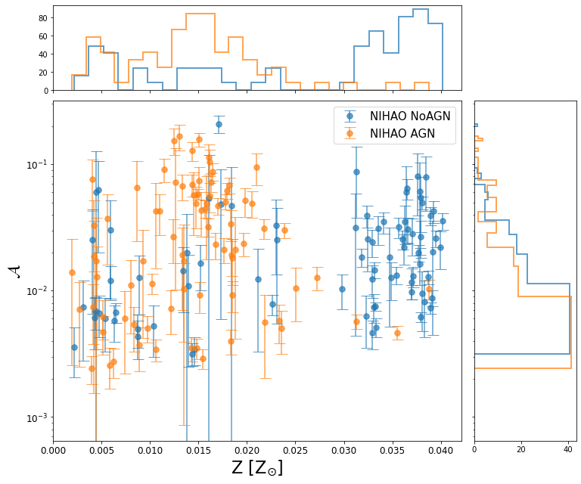
𝒜 vs. Scaling relation quantities
Quenching indicators
Age
SFR in last 100 Myr
Z metallicity
AGN results in very different quenching indicators
𝒜 ,however, stays the same
GANomaly is probing what these quantities not covering

Slide 25
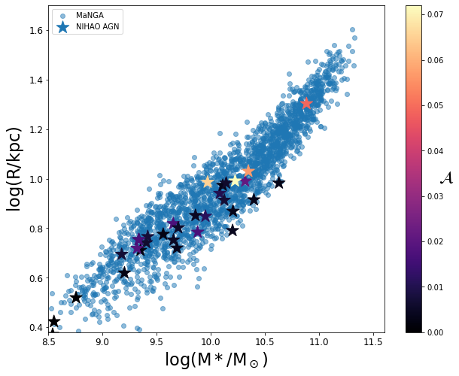
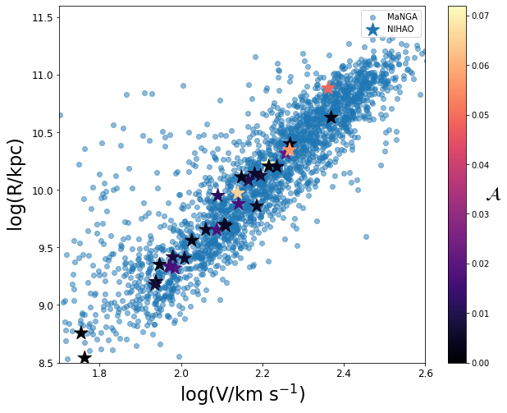
𝒜 vs. Scaling relations

Slide 26
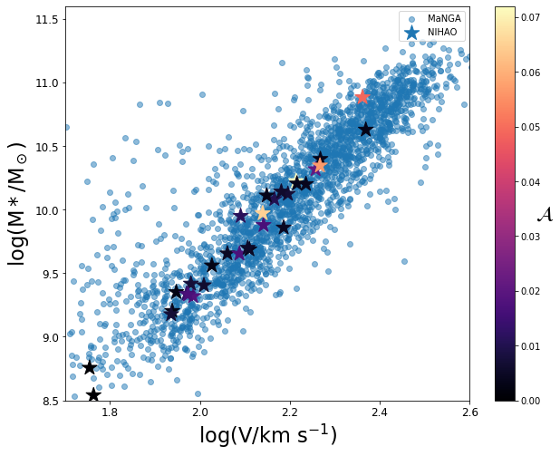
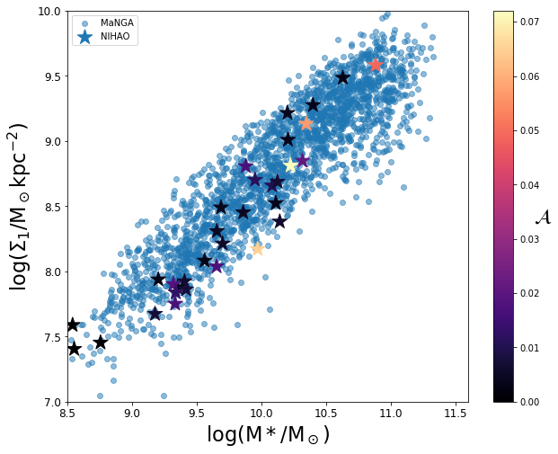
𝒜 vs. Scaling relations

Slide 27
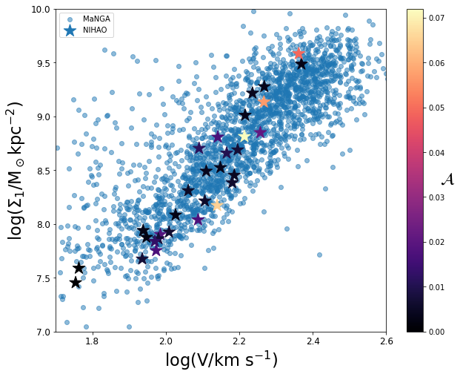
𝒜 vs. Scaling relations
The compliance to scaling relations is not related to 𝒜
𝒜 is complementary to scaling relations
Probes what scaling relations do not cover
Maybe probes deeper and more quantitative

Slide 28
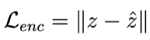
Does “background” matter?
A galaxy image contains the galaxy – but a large number of pixels are actually background. Can these effect the score?
PixelCNN, Zanisi et al. says background matters
Our score is not a pixel-by-pixel comparison, but the difference in feature space

Slide 29
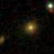
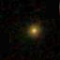
Does “background” matter?
Original SDSS image
“photoshop” Removal of background

Slide 30
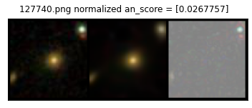
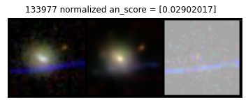
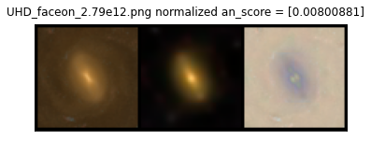
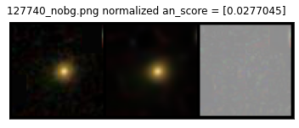
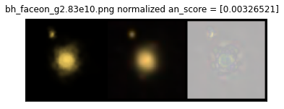
Does “background” matter?

Slide 31
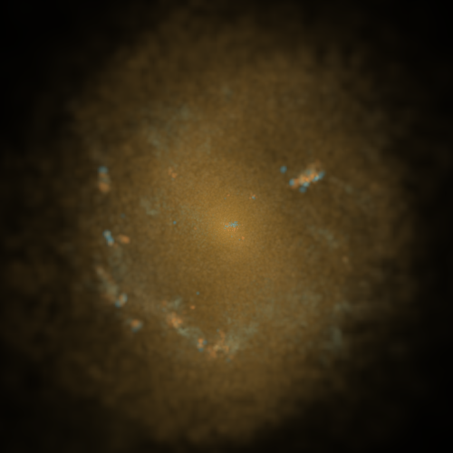
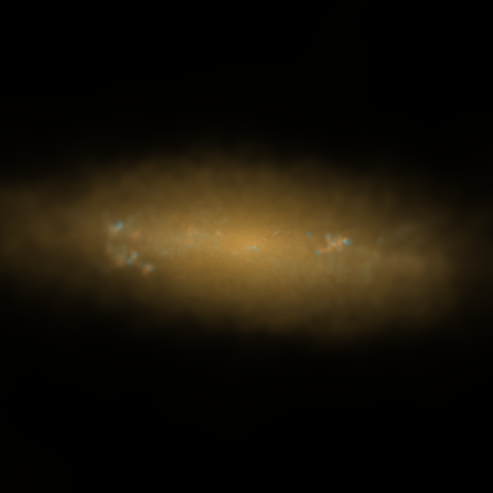
Does orientation matter?
Should face on and edge on of a same galaxy have the same score?
SHOULD have different scores

Slide 32
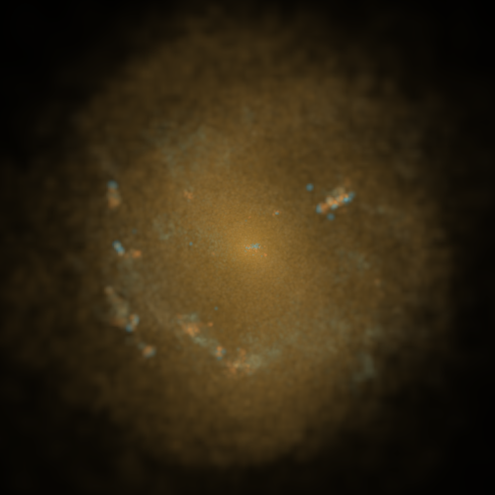
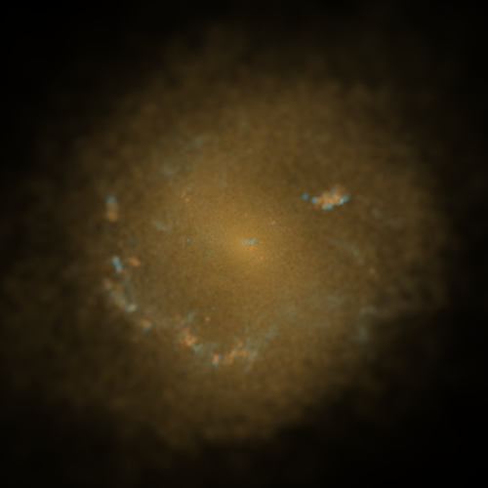
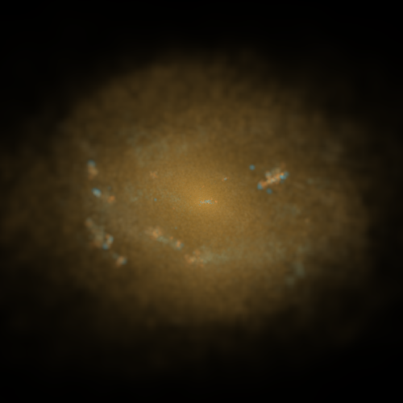
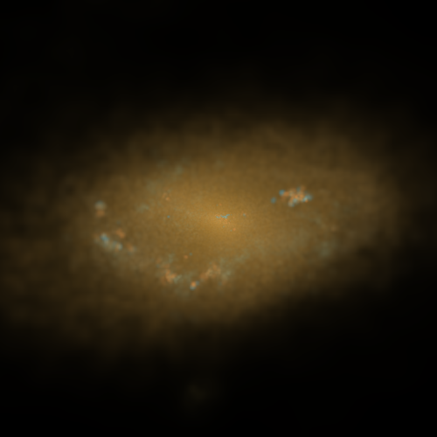
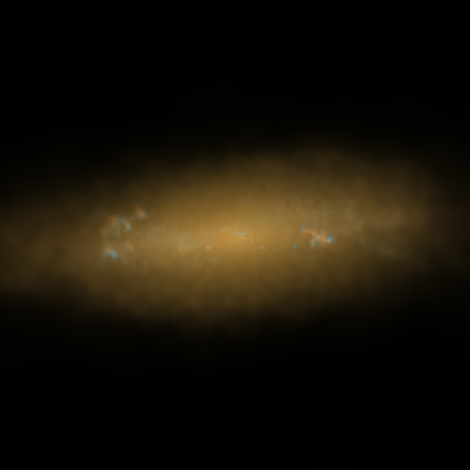
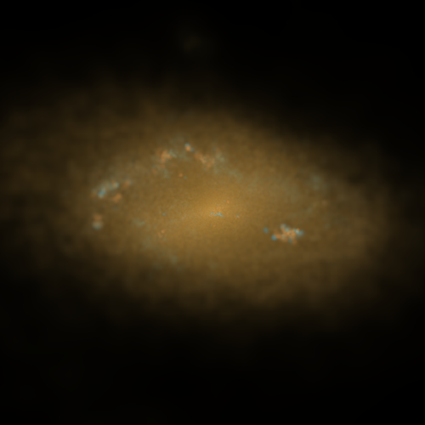
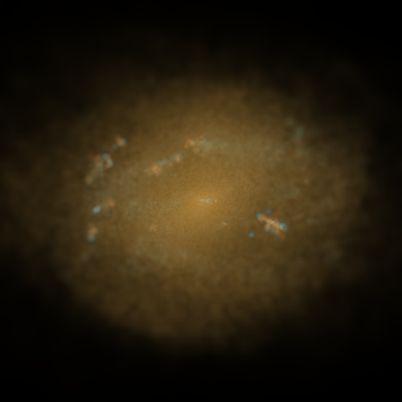
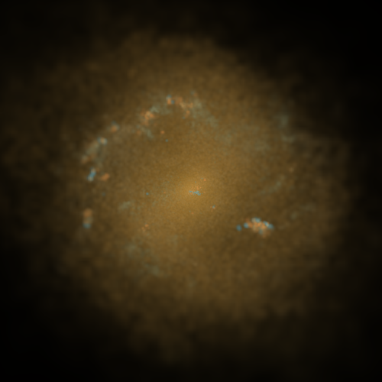


How does orientation effect the scores?

Slide 33


Slide 34

Face-on
Edge-on
Face-on
Edge-on
Face-on

Slide 35











How does orientation effect the scores?

Slide 36


Slide 37
Explore the 128 features
128-dimension feature space
Too many to interpret
They are not independent of each other
Principal Component Analysis (PCA)
Reduces 128D info into lower dimension Principal Components(PC)
Each PC is independent of each other

Slide 38


Explore the 128 features

Slide 39


Explore the 128 features
PC1, low to high
PC2, low to high
Apparent size small to big
Color yellow/red to blue

Slide 40

Explore the 128 features

Slide 41
What can NIHAO learn from this?
NIHAO produced more galaxies than apples
NIHAO is doing an okay (but not perfect) job
AGN vs NoAGN tie
n80 wins n10
UHD wins HD
NIHAO needs more effort to model the variety in stellar mass
NIHAO needs more effort to model the variety in colors

Slide 42
What can physicists learn from this?
A simple, ready-to-use model to rate any simulations
Very quantitative, gives you a score straight
To test, to tune parameters
Can re-train on different telescopes, different bands, different maps (velocity maps, density maps, etc.)
A complementary metric to scaling relations
Probes what current scaling relations do not cover
Rates simulation with higher dimensional info instead of two numbers
Exploring feature space
AI can learn interpretable features, such as color
Hints for high dimensionality in galaxy images
Fun to explore around the feature space!

Slide 43

Nearest neighbor in feature space

Slide 44
Thank you very much!

Slide 45
Backup slides

Slide 46









Performance on Test set
Original | reconstructed | residual

Slide 47









Performance on NIHAO images
Original | reconstructed | residual

Slide 48







Is this even working? Sanity check

Slide 49

SDSS RGB images
Light emitted from the source
Light travels through the universe and reaches CCD(charged coupled device) camera
Counts of photon received by CCDs gives the image
Credit: skyserver.sdss.org

Slide 50


SDSS RGB images
i filter – R channel
r filter – G channel
g filter – B channel
Credit: astroml.org
Credit: skyserver.sdss.org

Slide 51

SDSS RGB images
The last step, from “counts” in each pixels to a value in RGB channels (0~255 or 0~1)

Slide 52


SDSS RGB images
“Usual/old” approach
First, scale CCD r g b values as preferred
Turn r g b to channel R G B, with min/max value to display m/M
m&M are manually chosen to bring out favored details
Commonly $F\left(x\right)=ln⁡(x)$
Notes:
Disadvantage: blacks, whites, astronomical colors

Slide 53


SDSS RGB images
Lupton’s approach
Instead setting m&M, clip between 0 (or “m” by choice) and$⁡\max_{rgb}$
Instead of straight $F\left(x\right)=ln⁡(x)$ mapping,
$F\left(x\right)=\operatorname{arcsinh}\left(a∙Q\left(x−m\right)\right)/Q$
Linear part shows faint features
logarithmic part enables us to simultaneously put faint objects and significantly brighter objects on the same page
Credit: WolframAlpha
Notes:
Start NIHAO – we want to compare apples with apples

Slide 54
NIHAO RGB images
Simulations do not automatically keep track of colors
But we do keep track of metallicity, age, mass
We can get luminosity/magnitude from metallicity & age via color-magnitude diagram(CMD)
Pynbody’s default CMD does not cover SDSS i,r,g (r,g,b) bands
Account for the “fact” that light travels a long way before we see it

Slide 55


NIHAO RGB images
Luminosity/magnitude(“counts”) to R G B channel values (0~255 or 0~1)
Pynbody’s way:
Clip between $r_{max},g_{max},b_{max}$ and ${(r}_{max}+5),{(g}_{max}+5),{(b}_{max}+5)$
Clip between brightest and 100 times dimmer in R G B respectively
Mapping is always $F\left(x\right)=ln⁡(x)$

Slide 56


NIHAO RGB images
With correct bands in RBG channels and Lupton's clipping and mapping, we can hopefully get a SDSS-style RGB image
pynbody defalut i,v,u band
SDSS-style i,r,g band

Slide 57

NIHAO RGB images
Code is available for everyone to use
Copy falcon2/home/zj448/Radiative_transfer/homemade_render.py
to your working folder
Notes:
Now we have the images

